Slide 1
A SECURE AND SMART HOME AUTOMATION SYSTEM WITH SPEECH
RECOGNITION AND POWER MEASUREMENT CAPABILITIES
Presented by
Batch no:C10
V .TEJA SATYA SRINIVAS 21NG1A04C6
R.MOHANVENKATADASU 21NG1A04E1
V.KAVITHA 22NG5A0431
M.DURGA MALLESWARI 21NG1A04C3
Under the Esteemed Guidance of
Mr.G.Rajesh babu M.Tech
Assistant professor
DEPARTMENT OF ELECTRONICS & COMMUNICATION ENGINEERING

Slide 2
CONTENTS
ABSTRACT
INTRODUCTION
LITERATURE SURVEY
EXISTING SYSTEM
EXISTING SYSTEM BLOCK DIAGRAM
EXISTING SYSTEM DRAWBACKS
PROPOSED SYSTEM NECESSITY(Problem Identification)
PROPOSED SYSTEM BLOCK DIAGRAM
9. PROPOSED SYSTEM EXPLANATION
10. PROJECT REQUIREMENTS
a)HARDWARE
b)SOFTWARE
11. RESULTS AND ITS ANALYSIS
12. ADVANTAGES
13. APPLICATIONS
14. CONCLUSIONS
15. REFERENCES

Slide 3
1.ABSTRACT
The advancement in the internet of things (IoT) technologies has made it possible to control and monitor electronic devices at home with just the touch of a button.
Elderly people and those with disabilities have especially benefited from voice-assisted home automation systems that allow them to control their devices with simple voice commands.
However, the widespread use of cloud-based services in these systems, such as those offered by Google and Amazon, has made them vulnerable to cyber-attacks.
To ensure the proper functioning of these systems, a stable internet connection and a secure environment free from cyber-attacks are required.

Slide 4
2.INTRODUCTION
Significance of Home Automation Systems
Home automation systems have become essential in modern living, offering a seamless interface for controlling home appliances and enhancing quality of life. These systems provide convenience, improve security, and contribute to energy efficiency by automating everyday tasks and monitoring energy usage.
Objective of the Home Automation
The main objective of home automation is to enhance convenience, security, energy efficiency, and accessibility of home appliances.
Appliances through voice commands.
Voice-controlled home automation allows users to operate household appliances using voice assistants like Amazon Alexa, Google Assistant, and Apple Siri.
Enhance Security: Enhancing security in home automation involves protecting both the physical and digital aspects of your smart home.

Slide 5
3.LITERATURE SURVEY
1.Title: Hardware Security Threats Against Bluetooth Mesh Networks
Author: Alexandre Adomnicai,Jacques J. A. Fournier,Laurent Masson
Techniques: Side-Channel Attacks (SCAs),Fault Injection Attacks,Firmware Manipulation
Parameters: Device Identification and Authentication,Key Management
Drawbacks: Physical Access Vulnerability,Device Cloning,Hardware Trojans
Year: 2018
2.Title: Voice controlled home automation system using Natural Language Processing (NLP) and Internet of Things (IoT)
Author: Paul Jasmin Rani; Jason Bakthakumar; B. Praveen Kumaar; U. Praveen Techniques: Speech-to-Text Conversion (STT),Cloud-Based NLP Processing
Parameters: Speech Input,Voice Features,Language model selection
Drawbacks: Privacy Concerns,Dependency on Internet Connectivity
Year: 2017

Slide 6
LITERATURE SURVEY
3.Title: .Offline Smart Home Automation System with Automatic Speech Recognition and Household Power Usage Tracking
Author: Irugalbandara, I.B.C.; Naseem, A.S.M.; Perera, M.S.H.; Logeeshan..
Techniques: Local Speech Recognition Models,Voice Command Parsing and NLP,Energy Metering and Smart Plugs
Parameters:Offline Operation,Local Device Communication,Automatic Speech Recognition (ASR)
Drawbacks: Limited Device Interoperability,Scalability Issues,Complex Setup and Maintenance
Year: 2022
4.Title: Low Cost Home Automation Using Offline Speech Recognition
Author: Prasanna G,Ramadas
Techniques: Offline Speech Recognition,Microcontrollers and Single-Board Computers (SBCs)
Parameters: Wake Word Detection,Microphone Quality,Embedded Speech Recognition Model
Drawbacks: Limited Processing Power,Limited Vocabulary,Energy Consumption
Year: 2014

Slide 7
LITERATURE SURVEY
5.Title: Design and implementation of smart home energy management systems using green energy.
Author: Zhen, Y.Maragatham, T.; Mahapatra, R.P.
Techniques: Optimization Algorithms,Grid Interaction,Energy Storage Systems.
Parameters:Renewable Energy Production,Real-Time Monitoring and Control,User Comfort and Experience
Drawbacks: Initial Setup Cost,Intermittency of Renewable Energy,Energy Storage Challenges
Year: 2021
6.Title: Offline Smart Home Automation System with Automatic Speech Recognition and Household Power Usage Tracking
Author: I.B.C. Irugalbandara; A.S.M. Naseem; M.S.H. Perera; V. Logeeshan
Techniques: Automatic Speech Recognition (ASR)
Parameters: Automatic Speech Recognition (ASR),Speech Input Quality,Household Power Usage Tracking
Drawbacks: Limited Functionality,Speech Recognition Accuracy,Privacy and Security
Year of publish: 2022

Slide 8
LITERATURE SURVEY
7.Title: Next generation home automation system based on voice recognition
Author: .Elsokah, M.M.; Saleh, H.H.; Ze, A.R.
Techniques: Voice Command Parsing,Local vs Cloud-Based Voice Recognition,Edge Computing
Parameters:Accuracy and Reliability,Privacy and Data Security
Drawbacks: Limited Contextual Understanding,Dependency on Internet Connectivity
Year: 2020
8.Title: Implementation and recent progress in cloud-based smart home automation systems
Author: Katuk, N.; Ku-Mahamud, K.R.; Zakaria, N.H.; Maarof, M.A
Techniques: Cloud Computing Infrastructure,Internet of Things (IoT) Integration
Parameters: IoT Devices and Sensors,Communication Protocols,Data Analytics
Drawbacks: Security and Privacy Concerns,Dependence on Internet Connectivity,Cost
Year of published: 2018

Slide 9
LITERATURE SURVEY
9.Title:Approach to secure internet of things applications using MQTT protocol
Year of published:2021
Techniques:secure IoT application using MQTT protocol
Parameters:MQTT Protocol,Authentication,Encryption,Quality of Service (QoS)
Drawbacks: Light weight and Efficient,Flexible Data Handling,Interoperability,realtime Communication
10.Title: Review on Security in Bluetooth Low Energy Mesh Network in
Correlation with Wireless Mesh Network Security
Year of published:2019
Techniques: security review of Bluetooth Low Energy mesh networks
Parameters: Mesh Networking Topology,Security Mechanisms,Key
Drawbacks: Enhanced Coverage,Redundancy,Low Energy Consumption, Security Features

Slide 10
LITERATURE SURVEY
S.No | Title | Year of Publish | Technique/Protocol/Method/Algorithm | Parameters | Advantages
1 | Implementation and recent progress in cloud-based smart home automation systems | 2018 | cloud-based smart home automation system | Cloud Infrastructure Device, Artificial Intelligence (AI) | Access Data Storage and Analysis, Collaboration And Integration
2 | Review on Security in Bluetooth Low Energy Mesh Network in Correlation with Wireless Mesh Network Security | 2019 | security review of Bluetooth Low Energy mesh networks | Mesh Networking Topology, Security Mechanisms,Key Distribution | Enhanced Coverage, Redundancy, Low Energy Consumption, Security Features

Slide 11
3 | Next generation home automation system based on voice recognition | 2020 | Next-generation voice recognition-based home automation system | Advanced Voice Recognition, Context Awareness, Local Processing Options | Hands-Free Operation, Increased Efficiency, Integration with Virtual Assistants
4 | Approach to secure internet of things applications using MQTT protocol | 2021 | secure IoT application using MQTT protocol | MQTT Protocol, AuthenticationEncryption, Quality of Service (QoS) | Light weight and Efficient, Flexible Data Handling
5 | Design and implementation of smart home energy management systems using green energy | 2021 | smart home energy management systems using green energy | Smart Meters,BatteryStorage,Smart Appliances | Increased Efficiency, Enhanced Comfort

Slide 12
6 | Implementation and recent progress in cloud-based smart home automation systems | 2018 | Cloud Computing Infrastructure, Internet of Things (IoT) Integration | IoT Devices and Sensors, Protocols, Data Analytics | Access,Data Storage and Analysis, Collaboration and Integration
7 | Voice controlled home automation system using Natural Language Processing (NLP) and Internet of Things (IoT) | 2017 | Speech-to-Text Conversion (STT),Cloud-Based NLP Processing | Speech Input,Voice Features, Language model selection | Enhanced Coverage, Redundancy,Low Energy Consumption, Security Features
8 | Low Cost Home Automation Using Offline Speech Recognition | 2014 | Offline Speech Recognition, Microcontrollers and Single-Board Computers (SBCs) | Wake Word Detection, Microphone Quality, Embedded Speech Recognition | Light weight and Efficient, Flexible Data Handling

Slide 13
9 | Approach to secure internet of things applications using MQTT protocol | 2021 | secure IoT application using MQTT protocol | MQTT Protocol, Authentication,Encryption, Quality of Service (QoS) | realtime Applications
10 | Review on Security in Bluetooth Low Energy Mesh Network in Correlation with Wireless Mesh Network Security | 2019 | security review of Bluetooth Low Energy mesh networks | Mesh Networking Topology, Security Mechanisms, Key Distribution, Device | Increased Efficiency, Enhanced Comfort

Slide 14
4.EXISTING SYSTEM
Existing home automation systems are designed to provide users with convenience, security, and energy efficiency by enabling remote control of home appliances and monitoring energy usage. Key components and functionalities of these systems include:
Voice Processing: These systems often use voice recognition services provided by cloud platforms like Google Assistant, Amazon Alexa, or Microsoft Cortana. Voice commands are sent to these cloud services for processing, which then control the connected devices.
Connectivity: Devices in the system communicate through Wi-Fi, Bluetooth a stable internet connection is essential for these systems to function effectively, as the cloud-based voice processing and control depend on it.
Mobile App Integration: Users can control their home appliances through mobile applications that interface with the cloud services. These apps allow users to send commands, monitor device status, and receive alerts.

Slide 15
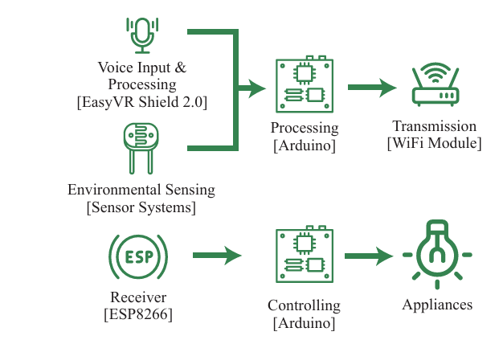
5.EXISTING BLOCK DIAGRAM

Slide 16
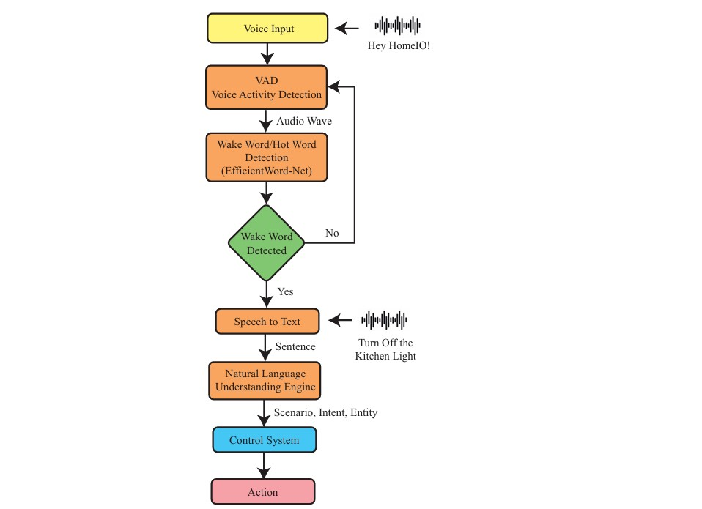
Speech Recognition Process

Slide 17
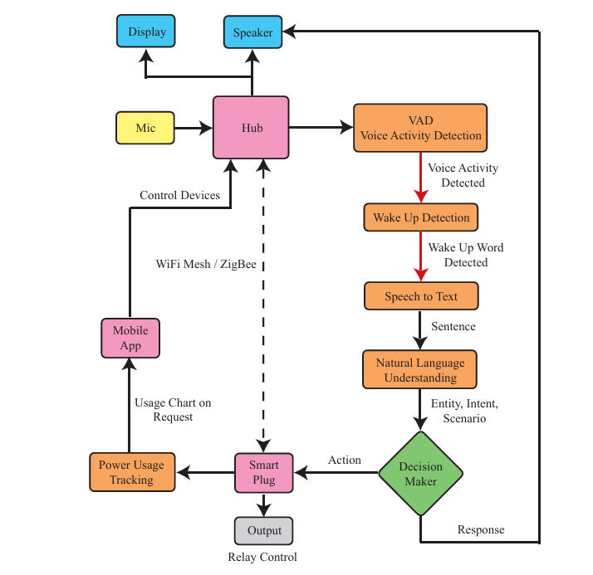
System Architecture

Slide 18
6.EXISTING SYSTEM DRAWBACKS
Limited Processing Power
Insufficient Memory
No Native Audio Processing Capability
Dependency on External Modules
Power consumption issues
Security Risks

Slide 19
7.PROPOSED SYSTEM NECESSITY
(Problem Identification)
The proposed home automation system significantly enhances security, privacy, and functionality compared to existing cloud-based systems. It offers:
Enhanced Security and Privacy: Raspberry Pi 4 has a built-in encryption and requires more
authentication securities.
Advanced Speech Recognition: Raspberry Pi 4 is better for speech recognition it has higher processing power and built-in wifi and Bluetooth support.
Efficient Power Management: Raspberry Pi 4 is powerful microcontroller and it has low-power modes and ULP processors.
Improved System Performance: It has a dual-core processor and high connectivity with multitasking processing.

Slide 20
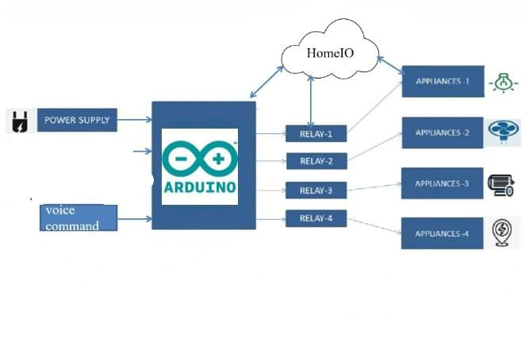
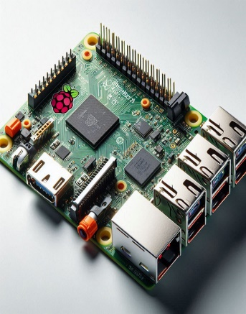
8.PROPOSED BLOCK DIAGRAM
Wifi module
Voice input
(Raspberry pi)
Speech
Recognition
process

Slide 21
9.PROPOSED METHOD
.The proposed system is a secure and smart home automation solution based on the
Raspberry Pi 4 which integrates speech recognition, power measurement, and security features. The system is designed to offer an easy, affordable, and efficient way to automate home devices, monitor energy consumption, and enhance home security, while also enabling remote control via a mobile application.
.Voice Command Control: The speech recognition module listens for specific commands and sends corresponding instructions to the Raspberry Pi 4. The Raspberry Pi 4 processes these instructions and controls the connected relays to operate appliances accordingly.
Power Monitoring: The voltage and current sensors continuously collect data from the appliances, and the Raspberry Pi 4 calculates the power consumption. This data can be sent to a mobile app for real-time monitoring.

Slide 22
10.PROJECT REQUIREMENTS
Hardware Requirements:
1.Sensors
2.Relays
3.Raspberry pi 4
4.Connecting wires
5.Bulbs

Slide 23
Software Requirements:
Python IDE
ThingSpeak IoT Cloud
Thingview Mobile App
RVNC Viewer

Slide 24
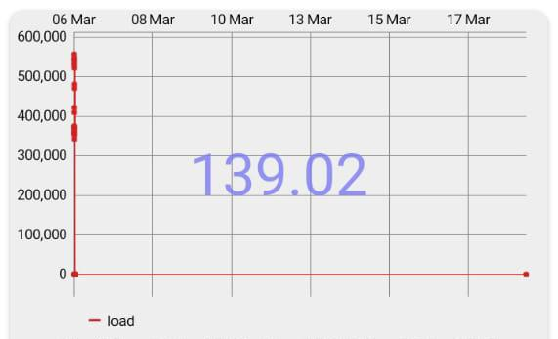
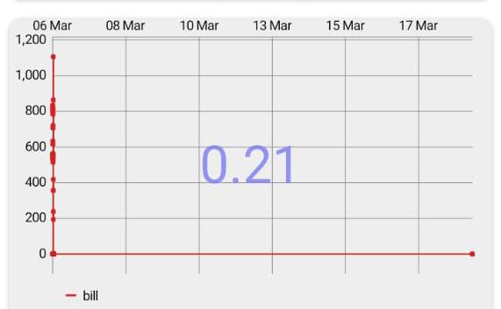
11.RESULTS AND ITS ANALYSIS

Slide 25
10.ADVANTAGES
Convenience: Hands-free control of home appliances through speech recognition.
Energy efficiency: Monitors power consumption, helping users reduce energy costs.
Enhanced security: Provides added safety through motion detection and door alarms.
Cost-effective: Uses affordable components like Arduino, making it accessible to a wide audience.
Remote access: Allows control and monitoring from any location using Wi-Fi.
User-friendly: Simple to operate with a focus on ease of installation and use.

Slide 26
APPLICATIONS
.Home automation: Control lighting, fans, and other appliances using voice commands.
Energy monitoring: Real-time power consumption measurement for efficient energy management.
Security systems: Integration of motion sensors, door alarms, and surveillance for home security.
Remote home control: Manage and monitor appliances via mobile apps and Wi-Fi.
Elderly or disabled assistance: Hands-free appliance control through speech recognition for ease of living.

Slide 27
14.CONCLUSIONS
Using the Raspberry Pi 4 for home automation through voice commands provides a cost-effective, customizable, and powerful solution for smart homes. With its robust processing power, multiple connectivity options, and compatibility with voice recognition software like Google Assistant or Mycroft AI, the Raspberry Pi 4 can efficiently control various smart devices.
This setup enhances convenience, energy efficiency, and security by allowing users to operate lights, appliances, and security systems using voice commands. Additionally, open-source support and community-driven development enable further improvements and customization.

Slide 28
REFERENCES
Irugalbandara, C.; Naseem, A.S.; Perera, S.; Kiruthikan, S.; Logeeshan, V. "A Secure and Smart Home Automation System with Speech Recognition and Power Measurement Capabilities," Sensors, 2023, 23, 5784. https://doi.org/10.3390/s23135784&#8203;:contentReference[oaicite:0]{index=0}.
automation systems. In Proceedings of the 2018 IEEE Symposium on Computer Applications & Industrial Electronics (ISCAIE
2018), Penang, Malaysia, 28–29 April 2018; pp. 71–77. [CrossRef]
Lau, J.; Zimmerman, B.; Schaub, F. Alexa, Are You Listening? Proc. ACM Hum.-Comput. Interact. 2018, 2. [CrossRef]
Irugalbandara, I.B.C.; Naseem, A.S.M.; Perera, M.S.H.; Logeeshan, V. HomeIO: Offline Smart Home Automation System with
Automatic Speech Recognition and Household Power Usage Tracking. In Proceedings of the 2022 IEEE World AI IoT Congress
(AIIoT), Seattle, WA, USA, 6–9 June 2022; pp. 571–577. [CrossRef]
Errobidart, J.; Uriz, A.J.; Gonzalez, E.; Gelosi, I.E.; Etcheverry, J.A. Offline domotic system using voice comands. In Proceedings of
the 2017 Eight Argentine Symposium and Conference on Embedded Systems (CASE), Buenos Aires, Argentina, 9–11 August
2017; pp. 25–30. [CrossRef]
EasyVR 3 Plus Shield for Arduino—COM-15453-SparkFun Electronics. Available online: https://www.sparkfun.com/products/
15453 (accessed on 24 July 2022).

Slide 29
QUERIES ?

Slide 30
THANK YOU

